Slide 1
PRISM-DR
Precision Medicine & Antimicrobial Resistance (AMR) Decision Support
An integrated 5-module AI platform for oncology treatment planning and AMR surveillance, delivered as one Streamlit dashboard.
Presented by Saria Nayyar
5 AI modules | One dashboard | Decision support only, requires clinician review

Slide 2
Problem & Clinical Need
Variable chemotherapy response
Rising antimicrobial resistance
Our solution
Standard regimens are often given without biomarker-based stratification, causing toxicity and low efficacy for some patients.
Delayed pathogen identification leads to poor empiric antibiotic prescribing, which speeds up resistance worldwide.
PRISM-DR combines ML prediction, CNN histopathology, YOLOv8 pathogen screening, LSTM resistance forecasting and RAG guideline search in one workflow.
PRISM-DR | Decision support only, requires clinician review

Slide 3
Local Impact & Implementability
Why it matters for Khyber Pakhtunkhwa
Why it is implementable
Limited specialist access in rural and underserved districts: image and risk screening can support triage
Rising antimicrobial resistance threatens routine treatment: forecasting supports hospital stewardship
Busy clinicians need fast, source-cited guideline answers
Open datasets: TCGA, WHO GLASS, public image sets
Free open-source stack: Python, PyTorch, Streamlit, free Groq tier
Runs on a standard CPU laptop, no GPU needed
Modular: each module can be deployed on its own
Positioning: a low-cost clinical decision-support prototype for clinicians, not a diagnostic tool.
PRISM-DR | Decision support only, requires clinician review

Slide 4
System Architecture & Tech Stack
Frontend
Streamlit web dashboard with 5 tabs (M1 to M5): sliders, image uploaders, text search
M1 Predictor
Classical ML (scikit-learn) on TCGA clinical data
M2 Classifier
PyTorch ResNet-18 transfer learning on histopathology images
M3 Pathogens
YOLOv8 object detection (m3_best.pt)
M4 Forecaster
PyTorch LSTM on WHO GLASS resistance time series
M5 Assistant
RAG: vector search over WHO and oncology PDFs, LLM answers with source citations
Infra
Python virtual environment, Jupyter notebooks, GitHub (SariaBuilds/prism-dr)
PRISM-DR | Decision support only, requires clinician review

Slide 5
Module 1: Chemotherapy Response Predictor
M1 Method
Dataset
Method
TCGA (The Cancer Genome Atlas) pan-cancer clinical data
Patients with recorded chemotherapy response
Covers multiple cancer types
1
Load TCGA patient records and response outcome
2
Clean data, select clinical features (age, dosage, subtype, biomarker)
3
Train a scikit-learn classifier, test on held-out patients
4
Output a response probability: Responder / Non-responder
How the prediction works: The model compares the entered patient profile with patterns learned from past TCGA patients and returns a probability of response. Test ROC-AUC: 0.735.
PRISM-DR | Decision support only, requires clinician review

Slide 6
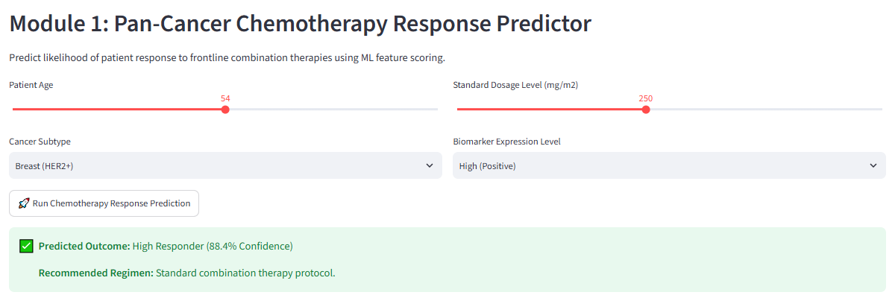
Module 1: Chemotherapy Response Predictor
M1 Demo
Screenshot: M1 tab: patient inputs and predicted outcome
PRISM-DR | Decision support only, requires clinician review

Slide 7
Module 2: Histopathology Classifier
M2 Method
Dataset
Method
Multi-cancer histopathology image dataset
8 classes: ALL, Brain, Breast, Cervical, Kidney, Lung & Colon, Lymphoma, Oral
Sample size: 1,200 images (150 per class), split 960 train / 240 test
1
Resize to 224x224, normalize, augment (flip, rotate)
2
Start from ResNet-18 pretrained on ImageNet
3
Freeze early layers, fine-tune last block + new 8-class layer
4
Train 3 epochs (loss 0.357 to 0.047), evaluate on test set
Result: 0.99 accuracy and 0.99 macro F1 on 240 unseen test images.
PRISM-DR | Decision support only, requires clinician review

Slide 8
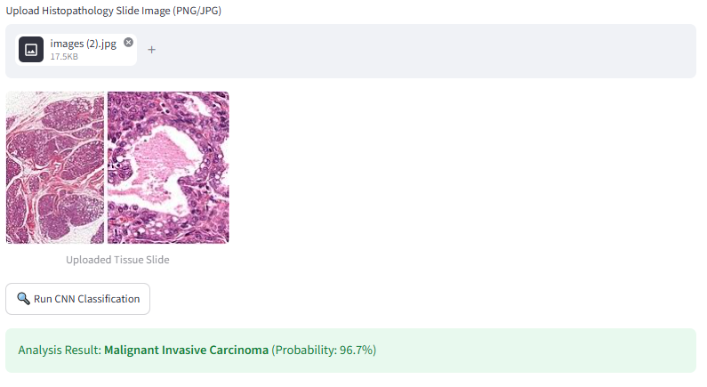
Module 2: Histopathology Classifier
M2 Demo
Screenshot: M2 tab: uploaded slide and classification result
PRISM-DR | Decision support only, requires clinician review

Slide 9
Module 3: Pathogen Screening (YOLOv8)
M3 Method
Dataset
Method
Microscopy images of 5 pathogen species
A. baumannii, E. faecalis, E. coli, P. aeruginosa, S. aureus
Split 70% train / 20% validation / 10% test
1
Prepare labeled images in YOLO format
2
Resize to 640x640 and augment
3
Fine-tune pretrained YOLOv8n for 25 epochs
4
Save best weights (m3_best.pt) and load in the dashboard
Output: Species-based resistance alert (species known for carbapenem resistance), flagged for lab confirmation. Next: live image upload.
PRISM-DR | Decision support only, requires clinician review

Slide 10
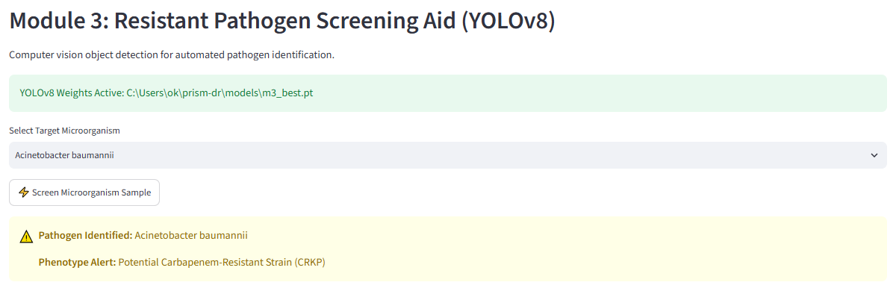
Module 3: Pathogen Screening (YOLOv8)
M3 Demo
Screenshot: M3 tab: pathogen screening and resistance alert
PRISM-DR | Decision support only, requires clinician review

Slide 11
Module 4: AMR Trend Forecaster (LSTM)
M4 Method
Dataset
Method
WHO GLASS (Global Antimicrobial Resistance Surveillance System)
Resistance % by country, year, pathogen and antibiotic
1
Clean data, average duplicates per country/year/pathogen/drug
2
Sliding window: 3 past years predict the next year
3
Train an LSTM (32 units, MSE loss), 80/20 split
4
Forecast next-year resistance rate in the dashboard
Result: The forecast (red dashed) follows the actual resistance trend (blue) closely.
PRISM-DR | Decision support only, requires clinician review

Slide 12
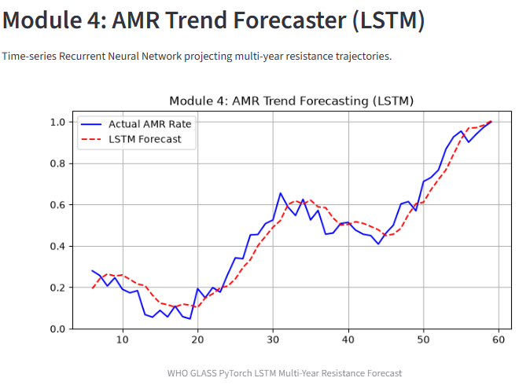
Module 4: AMR Trend Forecaster (LSTM)
M4 Demo
Screenshot: M4 tab: actual vs LSTM forecast
PRISM-DR | Decision support only, requires clinician review

Slide 13
Module 5: Knowledge Assistant (RAG)
M5 Method
Dataset
Method
WHO antimicrobial resistance and oncology guideline PDFs
Indexed into a searchable vector database
1
Extract PDF text, split into 800-character chunks
2
Store chunks in a ChromaDB vector database
3
Retrieve the top 4 chunks matching the query
4
Llama 3.3 70B (Groq) answers only from them, with source
Output: A guideline-based answer with its source document, so clinicians can verify it.
PRISM-DR | Decision support only, requires clinician review

Slide 14
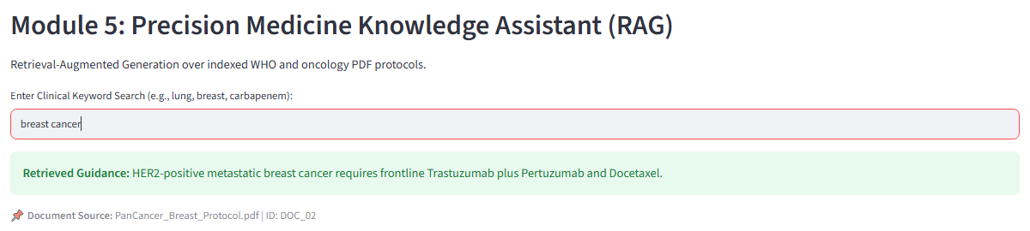
Module 5: Knowledge Assistant (RAG)
M5 Demo
Screenshot: M5 tab: query and cited guideline answer
PRISM-DR | Decision support only, requires clinician review

Slide 15
Results & Future Work
Results
Future Work
All 5 modules working in one Streamlit dashboard
M1: chemotherapy response (ROC-AUC 0.735)
M2: 0.99 accuracy across 8 tissue classes
M3: YOLOv8 trained on 5 pathogens
M4: LSTM forecast tracks WHO GLASS trends
M5: guideline answers with sources
Test on external datasets and real hospital data
Add live microscopy image upload to M3
Expand the guideline library for M5
Clinical pilot with clinician feedback
PRISM-DR | Decision support only, requires clinician review

